Slide 1
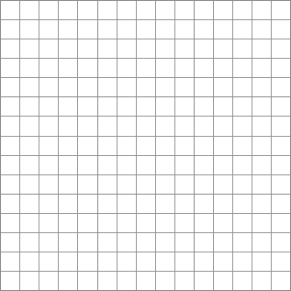
Algebras and Calculus of Numbers and Shapes
Much of spatial behavior can only be seen,
Not as some static quality of the space
But can only be viewed as an localized effect on motions,
Or the aggregation of such dynamic effects “in the round”
Example: curvature
“What is the curvature”?

Slide 2
Algebras and Calculus of Numbers and Shapes
Much of spatial behavior can only be seen,
Not as some static quality of the space
But can only be viewed as an localized effect on motions,
Or the aggregation of such dynamic effects “in the round”
Example: curvature
In the simple case of a circle, we can take a static view:
Curvature = 1/radius

Slide 3
Algebras and Calculus of Numbers and Shapes
Much of spatial behavior can only be seen,
Not as some static quality of the space
But can only be viewed as an localized effect on motions,
Or the aggregation of such dynamic effects “in the round”
Example: curvature
In the simple case of a circle, we can take a static view:
Curvature = 1/radius
Note:
Position varies
Direction varies
Direction to the center varies

Slide 4
Algebras and Calculus of Numbers and Shapes
Much of spatial behavior can only be seen,
Not as some static quality of the space
But can only be viewed as an localized effect on motions,
Or the aggregation of such dynamic effects “in the round”
Example: curvature
In the simple case of a circle, we can take a static view:
Curvature = 1/radius
Note:
Position varies
Direction varies
Direction to the center varies
The fact that the curvature is static indicates something “degenerate” about the shape

Slide 5
Algebras and Calculus of Numbers and Shapes
Much of spatial behavior can only be seen,
Not as some static quality of the space
But can only be viewed as a localized effect on motions,
Or the aggregation of such dynamic effects “in the round”
Example: curvature
“When I move along the curve,
My position changes”

Slide 6
Algebras and Calculus of Numbers and Shapes
Much of spatial behavior can only be seen,
Not as some static quality of the space
But can only be viewed as a localized effect on motions,
Or the aggregation of such dynamic effects “in the round”
Example: curvature
“When I move along the curve,
My position changes”

Slide 7
Algebras and Calculus of Numbers and Shapes
Much of spatial behavior can only be seen,
Not as some static quality of the space
But can only be viewed as a localized effect on motions,
Or the aggregation of such dynamic effects “in the round”
Example: curvature
“When I move along the curve,
My position changes”

Slide 8
Algebras and Calculus of Numbers and Shapes
Much of spatial behavior can only be seen,
Not as some static quality of the space
But can only be viewed as a localized effect on motions,
Or the aggregation of such dynamic effects “in the round”
Example: curvature
“When I move along the curve,
My position changes”

Slide 9
Algebras and Calculus of Numbers and Shapes
Much of spatial behavior can only be seen,
Not as some static quality of the space
But can only be viewed as a localized effect on motions,
Or the aggregation of such dynamic effects “in the round”
Example: curvature
“When I move along the curve,
My position changes”

Slide 10
Algebras and Calculus of Numbers and Shapes
Much of spatial behavior can only be seen,
Not as some static quality of the space
But can only be viewed as a localized effect on motions,
Or the aggregation of such dynamic effects “in the round”
Example: curvature
“When I move along the curve,
My position changes”
“And the change in my position changes”

Slide 11
Algebras and Calculus of Numbers and Shapes
Much of spatial behavior can only be seen,
Not as some static quality of the space
But can only be viewed as a localized effect on motions,
Or the aggregation of such dynamic effects “in the round”
Example: curvature
“When I move along the curve,
My position changes”
“And the change in my position changes”

Slide 12
Algebras and Calculus of Numbers and Shapes
Much of spatial behavior can only be seen,
Not as some static quality of the space
But can only be viewed as a localized effect on motions,
Or the aggregation of such dynamic effects “in the round”
Example: curvature
“When I move along the curve,
My position changes”
“And the change in my position changes”

Slide 13
Algebras and Calculus of Numbers and Shapes
Much of spatial behavior can only be seen,
Not as some static quality of the space
But can only be viewed as a localized effect on motions,
Or the aggregation of such dynamic effects “in the round”
Example: curvature
“When I move along the curve,
My position changes”
“And the change in my position changes

Slide 14
Algebras and Calculus of Numbers and Shapes
Much of spatial behavior can only be seen,
Not as some static quality of the space
But can only be viewed as a localized effect on motions,
Or the aggregation of such dynamic effects “in the round”
Example: curvature
“When I move along the curve,
My position changes”
“And the change in my position changes

Slide 15
Algebras and Calculus of Numbers and Shapes
Much of spatial behavior can only be seen,
Not as some static quality of the space
But can only be viewed as a localized effect on motions,
Or the aggregation of such dynamic effects “in the round”
Example: curvature
“When I move along the curve,
My position changes”
“And the change in my position changes”
“And the change in the change
in my position
changes”

Slide 16
Algebras and Calculus of Numbers and Shapes
Much of spatial behavior can only be seen,
Not as some static quality of the space
But can only be viewed as a localized effect on motions,
Or the aggregation of such dynamic effects “in the round”
Example: curvature
“When I move along the curve,
My position changes”
“And the change in my position changes”
“And the change in the change
in my position
changes”

Slide 17
Algebras and Calculus of Numbers and Shapes
Much of spatial behavior can only be seen,
Not as some static quality of the space
But can only be viewed as a localized effect on motions,
Or the aggregation of such dynamic effects “in the round”
Example: curvature
“When I move along the curve,
My position changes”
“And the change in my position changes

Slide 18
Algebras and Calculus of Numbers and Shapes
Much of spatial behavior can only be seen,
Not as some static quality of the space
But can only be viewed as a localized effect on motions,
Or the aggregation of such dynamic effects “in the round”
Example: curvature
“When I move along the curve,
My position changes”
“And the change in my position changes”
“And the change in the change
in my position
changes”

Slide 19
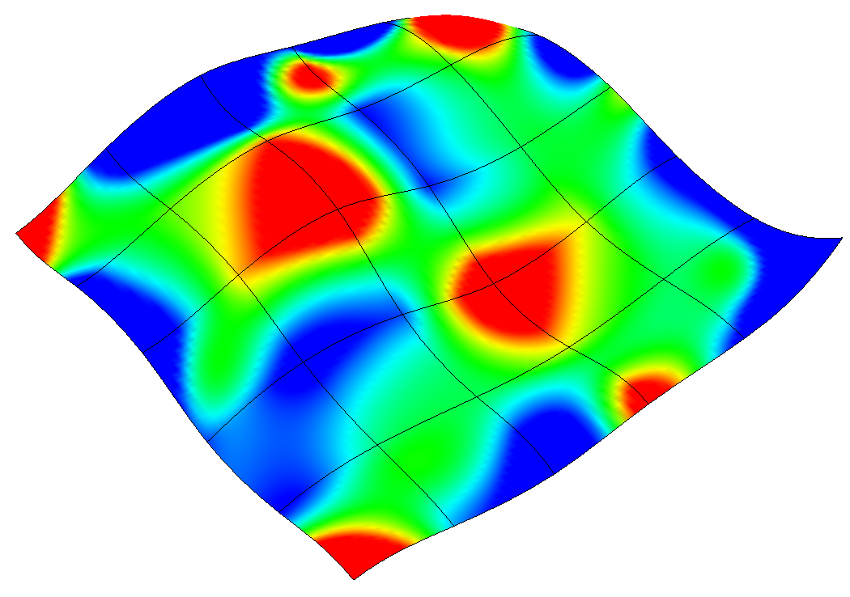
Algebras and Calculus of Numbers and Shapes
Example: surface curvature
“As I move along a surface…”

Slide 20
Algebras and Calculus of Numbers and Shapes
Example: surface curvature
“As I move along a surface …

Slide 21
Algebras and Calculus of Numbers and Shapes
Example: surface curvature
“As I move along a surface …
My change in position varies with the surface

Slide 22
Algebras and Calculus of Numbers and Shapes
Example: surface curvature
“As I move along a surface …
My change in position varies with the surface
and within the surface”

Slide 23
Algebras and Calculus of Numbers and Shapes
Much of spatial behavior can only be seen,
Not as some static quality of the space
But can only be viewed as a localized effect on motions,
Or the aggregation of such dynamic effects “in the round”
Example: curvature
“When I move along the curve,
My position changes”
“And the change in my position changes”
“And the change in the change
in my position
changes”

Slide 24
Calculus
See the world from 2 directions:
Myopically Differentiation
“What is the rate of change of distance as I move along the curve?”
(and many other characteristics)

Slide 25
Calculus
See the world from 2 directions:
Myopically Differentiation
Globally Integration
“What is the rate of change of distance as I move along the curve?”
(and many other characteristics)
“What is the overall distance (length) of the curve?”
(and many other characteristics)

Slide 26
Parametric Curves
old
explicit function

Slide 27
Parametric Curves
new
implicit function
old
explicit function

Slide 28
Parametric Curves
new
implicit function
old
explicit function

Slide 29
Parametric Curves
new
implicit function
old
explicit function

Slide 30

Parametric Curves
“Driving a little car in time” analogy
“time”

Slide 31
Parametric Curves
new
implicit function
Due to the independence of the basis functions x_{i} ,(orthonormality)
The functions f_{i} can be seen as completely independent:

Slide 32
Parametric Curves
“Driving a little car in time” analogy
“time”
velocity

Slide 33
Parametric Curves
“Driving a little car in time” analogy
“time”
velocity
acceleration

Slide 34
Reparameterization
A path in “time” (or some other independent parameter)

Slide 35
Reparameterization

Slide 36
Parametric Curves
“Driving a little car in time” analogy
“time”
We can imagine a
“special parameterization”
Where t is distance.
What happens??
velocity
acceleration

Slide 37
Parametric Curves
“Driving a little car in time” analogy
“time”
We can imagine a
“special parameterization”
Where t is distance.
What happens??
velocity
acceleration

Slide 38
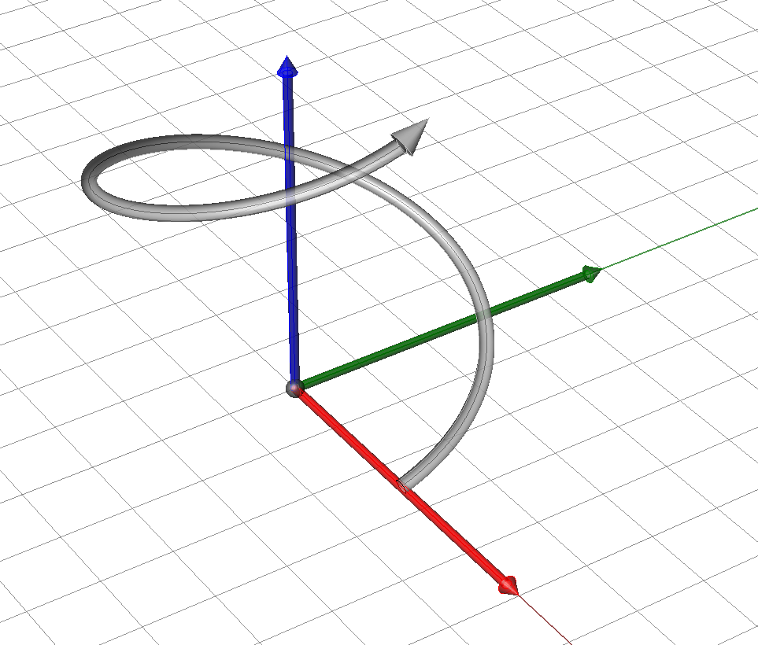
Classic Case: The “unit speed” Helix in 3D

Slide 39
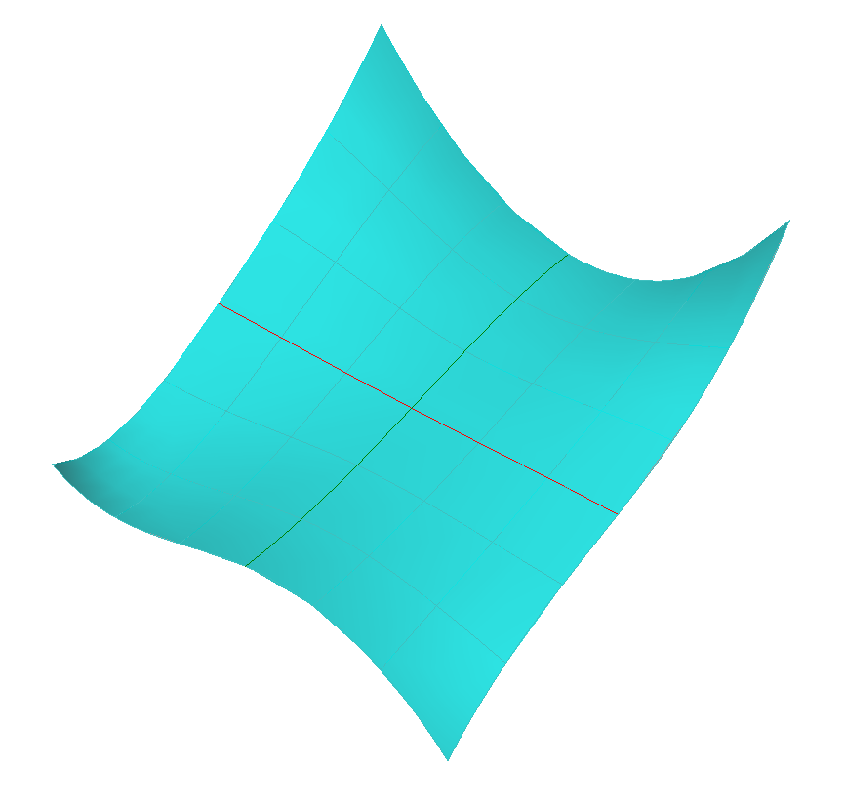
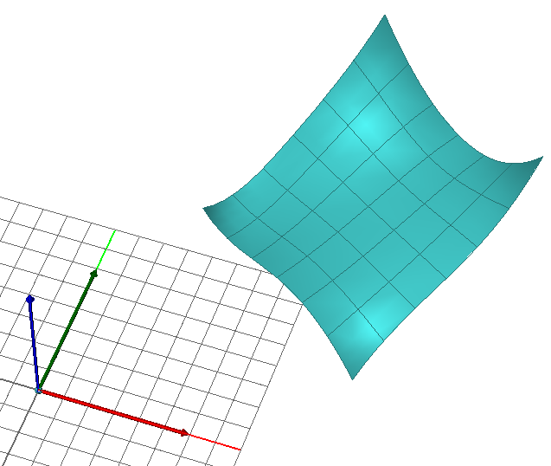
First form: in plane deformations
We talked about “stretchiness” at a point as the magnitude of the first derivatives of u and v
in u
σ_{v}
p
σ_{u}

Slide 40
First form: in plane deformations
We talked about “stretchiness” at a point as the magnitude of the first derivatives of u and v
in v
σ_{v}
p
σ_{u}

Slide 41
First form: in plane deformations
We talked about “stretchiness” at a point as the magnitude of the first derivatives of u and v
in uv (shear)
σ_{v}
p
σ_{u}

Slide 42
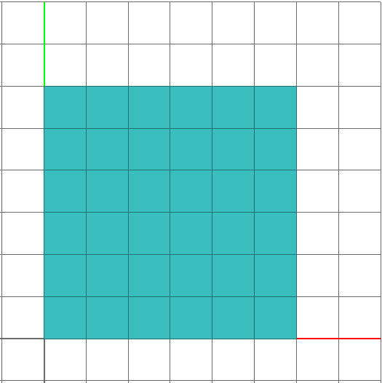
First form: in plane deformations
We talked about “stretchiness” at a point as the magnitude of the first derivatives of u and v
σ_{v}
p
p
σ_{u}
u
σ

Slide 43
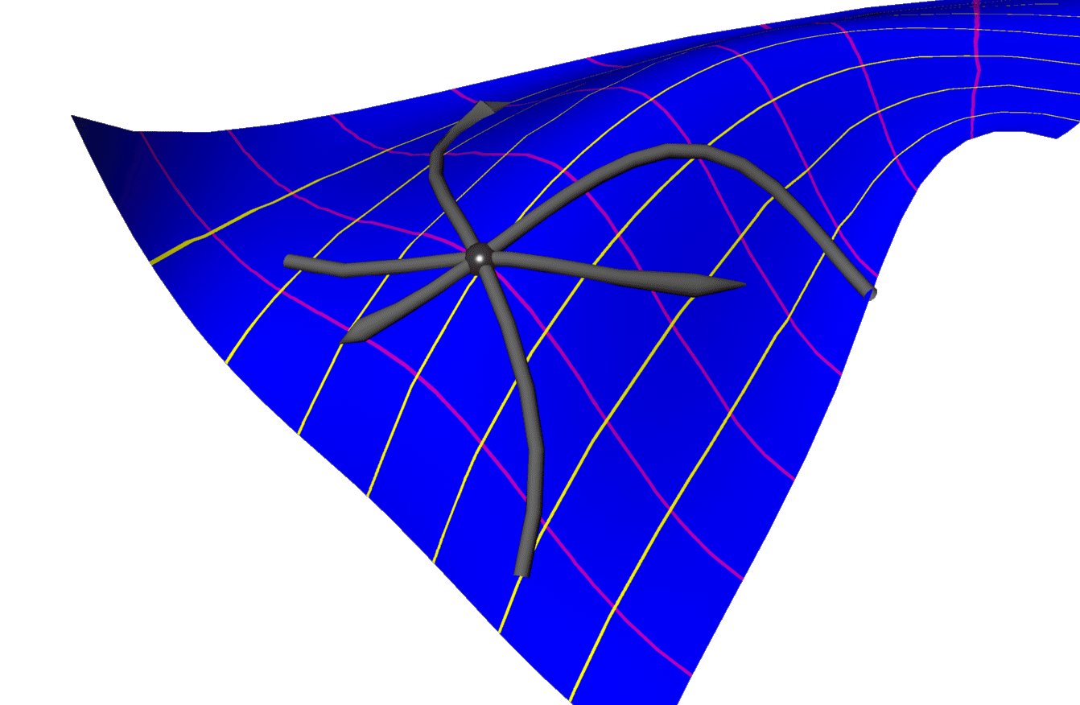
Second fundamental form
We did the same thing for all possible curvatures
(2nd derivatives)
of the curves of a surface…
p
σ_{u}
σ_{uu}

Slide 44
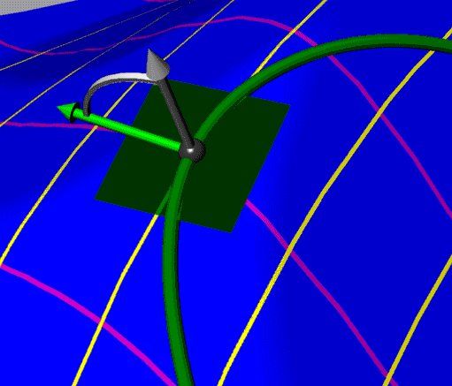
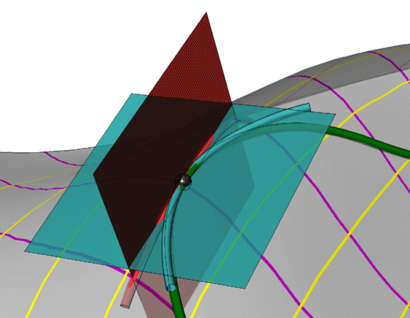
Second fundamental form
If we look at this from the frame defined by the curve tangent and the surface normal (and the vector perpendicular to both:
Normal curvature
Curve
tangent
Surface
Normal
In plane or geodesic curvature

Slide 45
Second fundamental form
Different surface curves with a given tangent direction
have different geodesic curvatures,
But the same normal curvature.
The normal curvature (in a given directions)
of a curve on the surface is
a feature of the surface itself.
Geodesic Curvature
“out of the plane”
Normal curvature
“In the plane of the surface normal”
Normal curvature
Surface
Normal
Curve
tangent
Geodesic
curvature circle
Normal
curvature circle

Slide 46
Second fundamental form
Different surface curves with a given tangent direction
have different geodesic curvatures,
But the same normal curvature.
The normal curvature (in a given directions)
of a curve on the surface is
a feature of the surface itself.
Geodesic Curvature
“out of the plane”
Surface
Normal
Curve
tangent
Geodesic
curvature circle
Normal
curvature circle

Slide 47
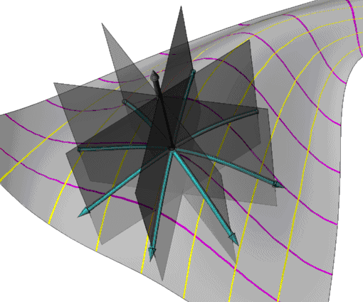
Principle directions
θ₁
v
θ₂
u
curvature
0
2π
as we pick different pairs of directions, we’ll
get different pairs of curvature values…
θ₁
θ₂

Slide 48
Bi- directions
θ₁
v
θ₂
u
curvature
0
2π
as we pick different pairs of directions, we’ll
get different pairs of curvature values…
θ₁
θ₂

Slide 49
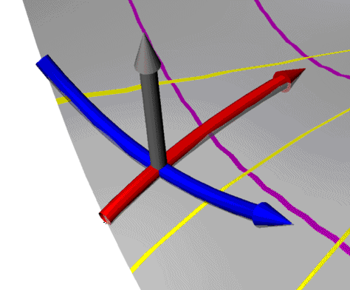
Gaussian curvature
We know that a parametric surface
is characterized by
“bivectors” (vectors2) describing:
It’s “acceleration” normal to the surface
And its “stretching” within the surface
σ_{v}
p
σ_{u}

Slide 50
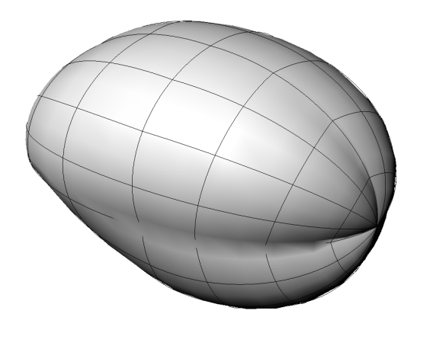
Principle directions
For each point on a surface there are 2 directions where the normal curvature are at a maximum and minimum.
These two “principle directions” characterize the surface curvature at the point
θ₁
v
θ₂
u
curvature
0
2π
θ₁
θ₂

Slide 51
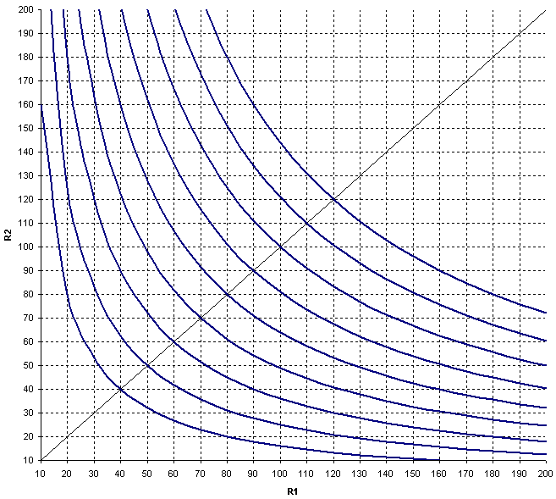
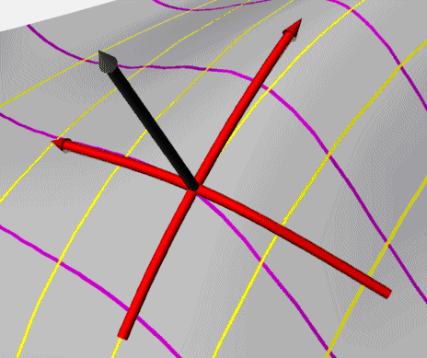
Gaussian Curvature: Definition and meaning #1
Q: What is
A: The geometric mean, or
“multiplicative average”

Slide 52
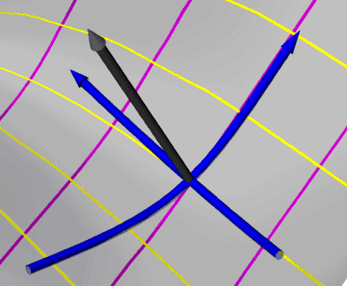
Curvature Sign characteristics
positive
“bowl”
whether they curve in the same direction
relative to the normal
or in opposing directions.
negative
“saddle”
curvature
0
2π
positive
“dome”
(“double negative”)

Slide 53
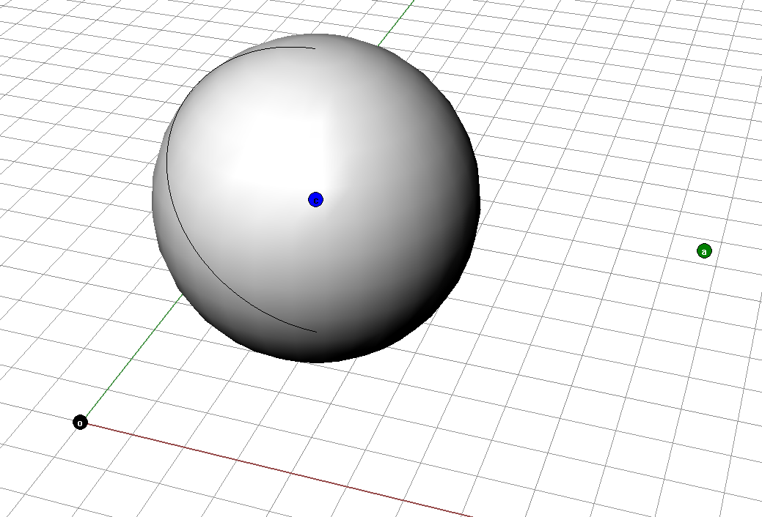
Gaussian Curvature: Definition and meaning #1
r
Example: what are
For a sphere of radius 10??

Slide 54

Gaussian Curvature: Definition and meaning #1
r
r1
r2

Slide 55
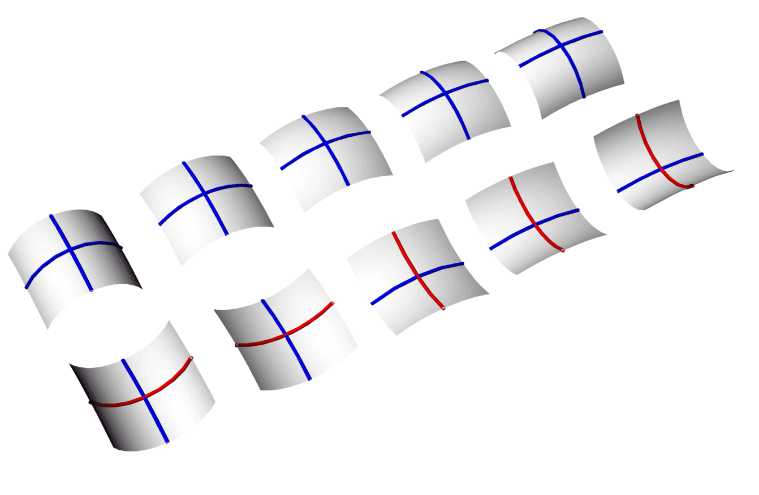
Gaussian Curvature: Definition and meaning #1
Equivalent Gaussian curvatures

Slide 56
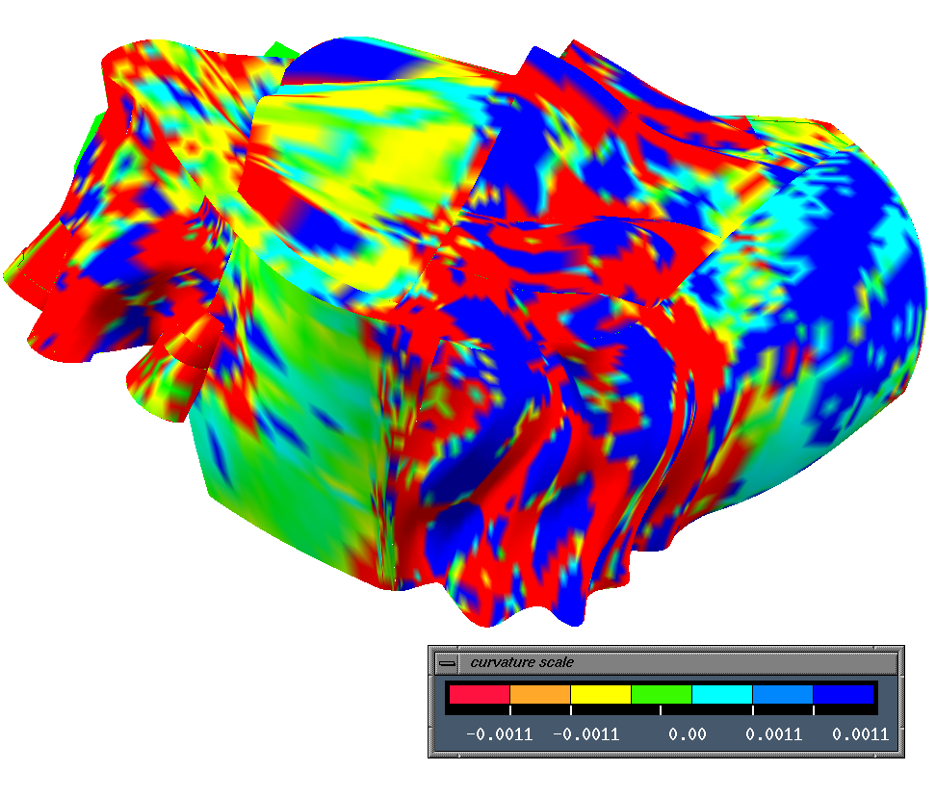
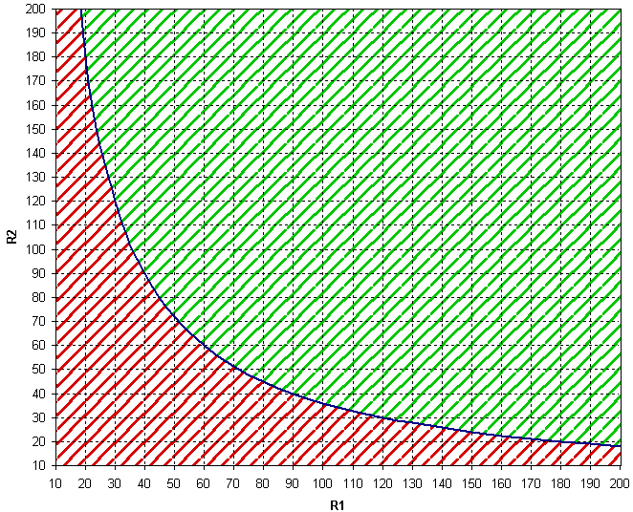
Gaussian Curvature
“OK”
“TOO MUCH”

Slide 57
Gaussian Curvature
System I
$
System II
$$$

Slide 58
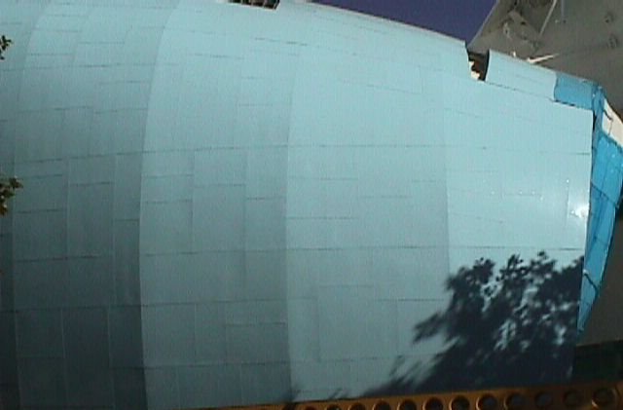
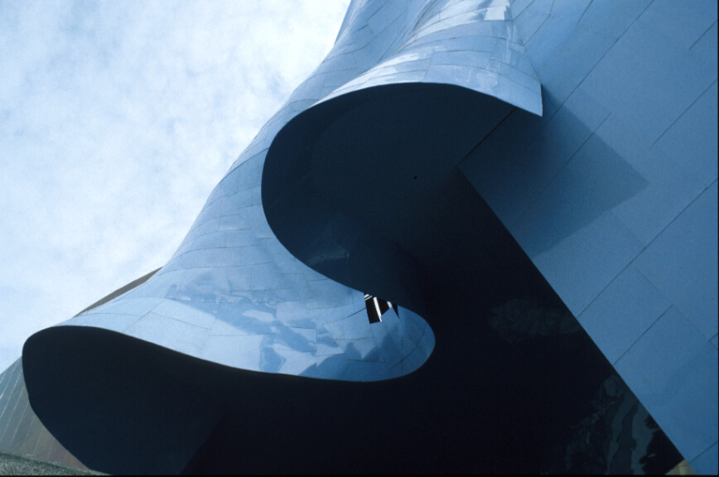
Gaussian Curvature
System I - $
System II - $$$

Slide 59
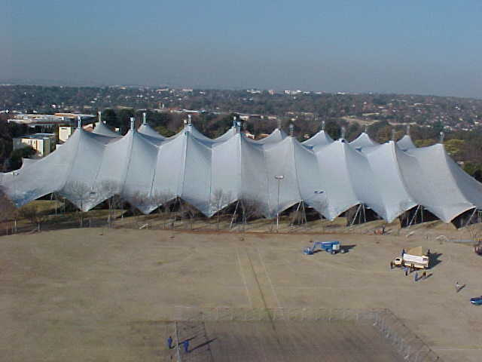

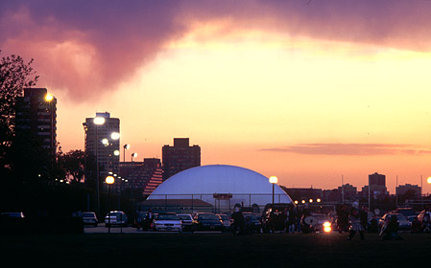
Interpretations of positive and negative gaussian curvature
+
-

Slide 60
Gaussian curvature: Definition and Meaning #2
+
-
The “opening or closing of the surface”

Slide 61

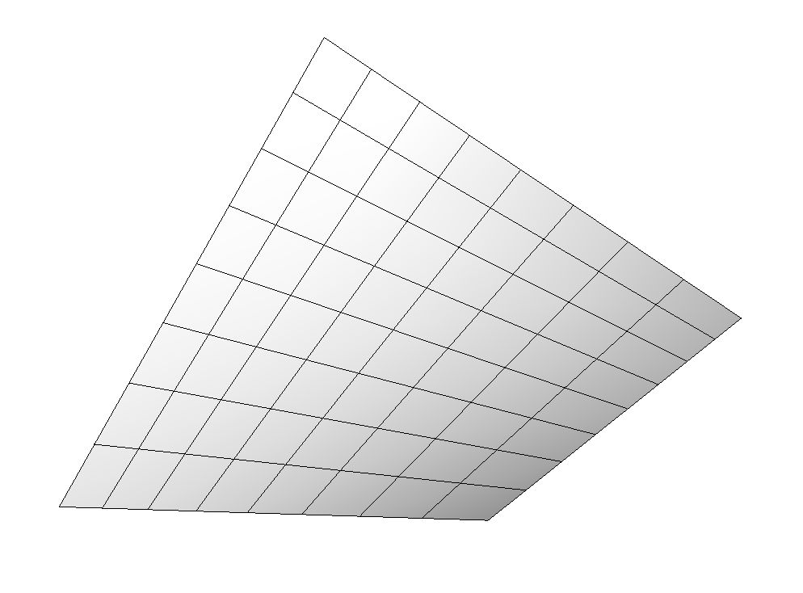
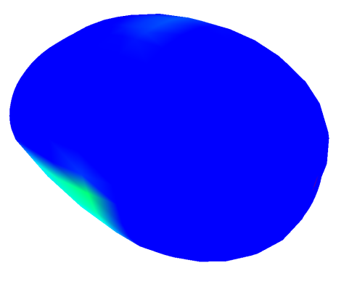
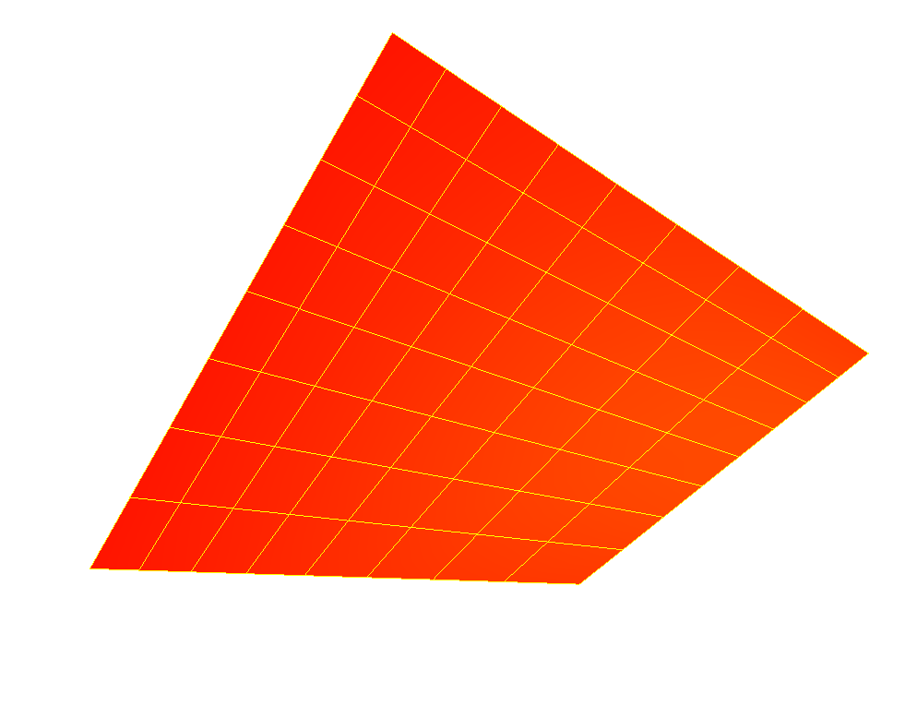
Gaussian curvature: Definition and Meaning #2
+
-
The “opening or closing of the surface”

Slide 62
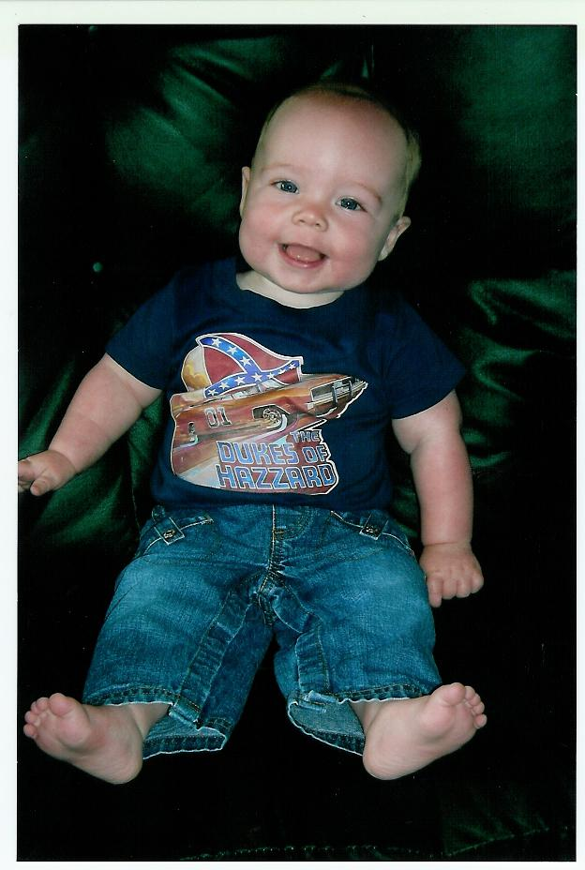
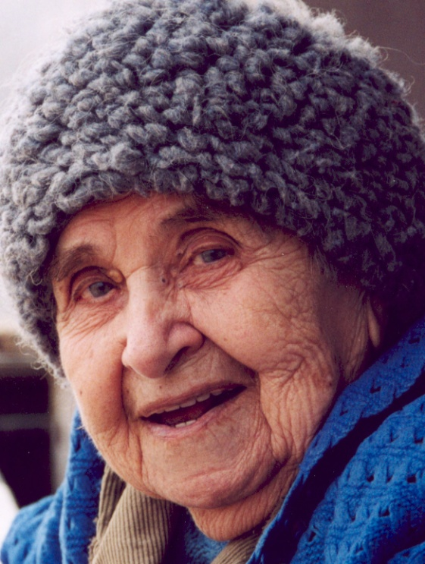
Gaussian curvature: Definition and Meaning #2
+
-
The “opening or closing of the surface”

Slide 63
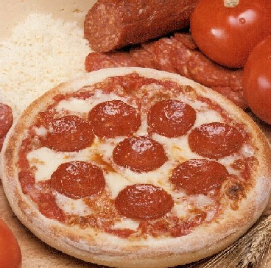
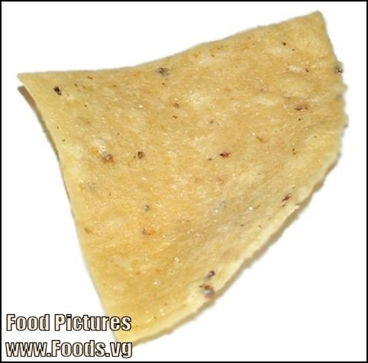
Interpretations of positive and negative gaussian curvature
+
-
Always positive
Always negative

Slide 64
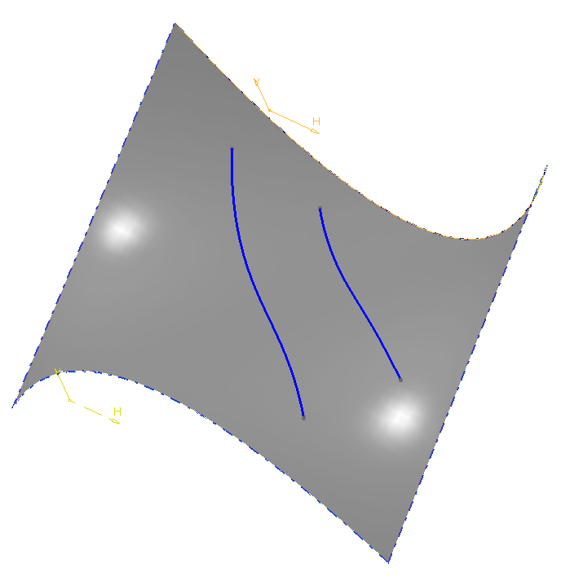
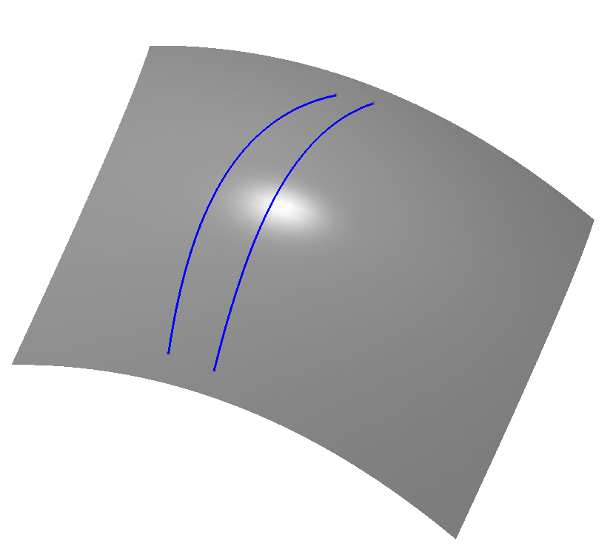
Gaussian curvature: Definition and Meaning #2
+
-
The “opening or closing of the surface”
Parallel geodesics
converge
Parallel geodesics
diverge

Slide 65
Special note on negative curvature surfaces
θ₁
θ₂
negative
“saddle”
What’s going on here??
What’s going on here??
curvature
0
2π

Slide 66
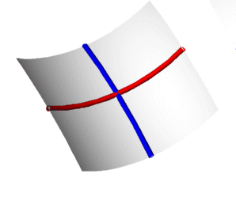
Special note on negative curvature surfaces
θ₁
θ₂
negative
“saddle”
curvature
0 curvature,
Asymptotic lines
0
2π

Slide 67
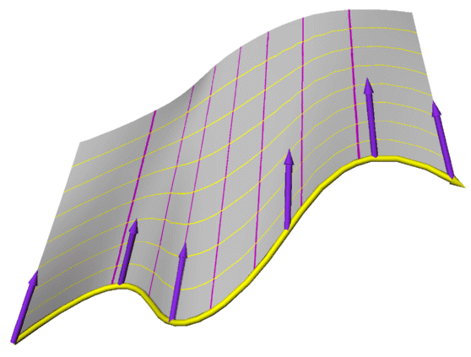
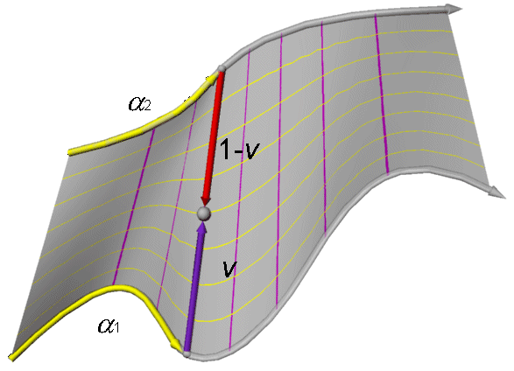
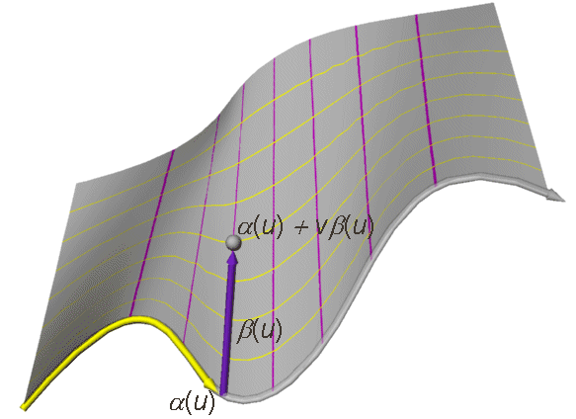
Ruled Surfaces
The envelope of a line along a curve in space
pointwise joining of
2 curves

Slide 68
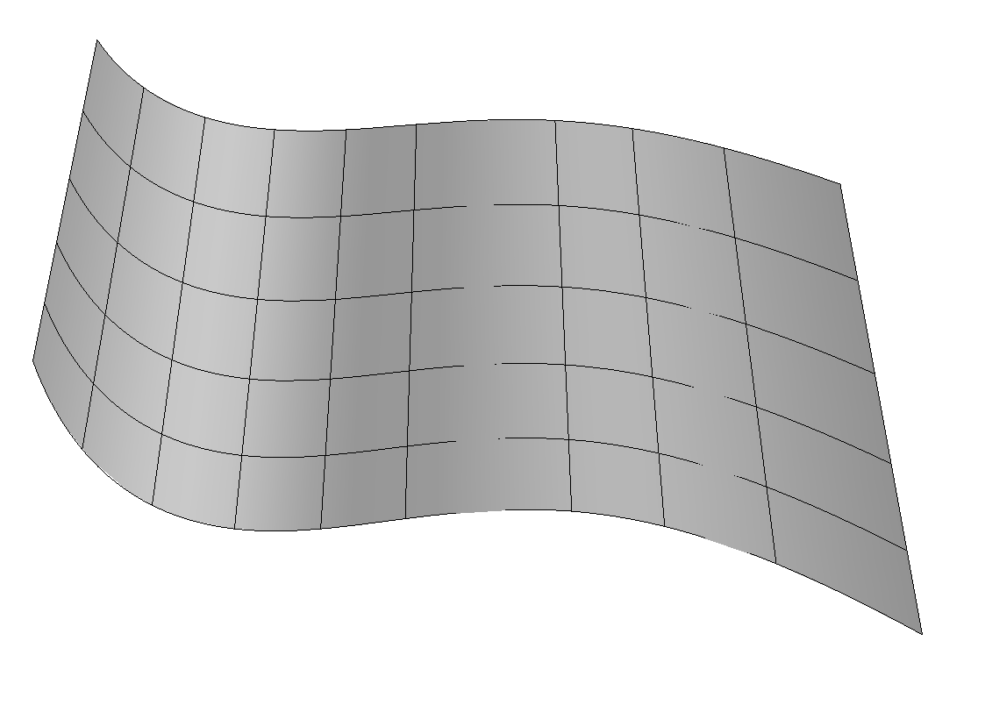
Developable Surfaces
+
0
Always zero
positive
-
negative

Slide 69
Gaussian curvature: Definition and Meaning #2
0
+
-
Always zero

Slide 70
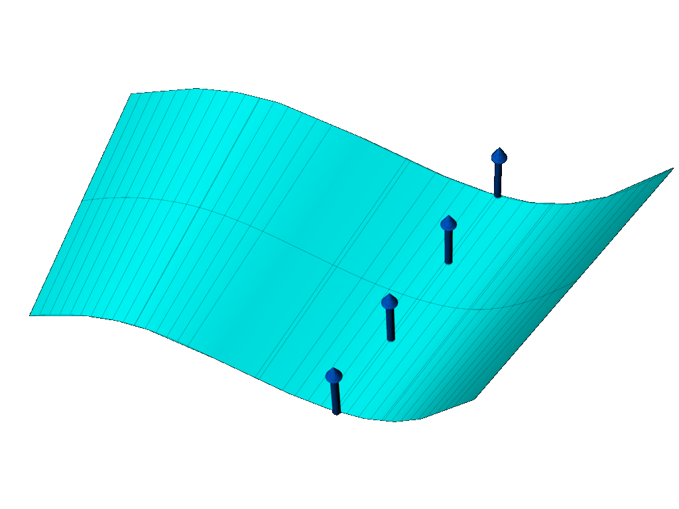
Developable Surfaces
0
Always zero
The surface normals
are parallel
And lie in a
common plane

Slide 71
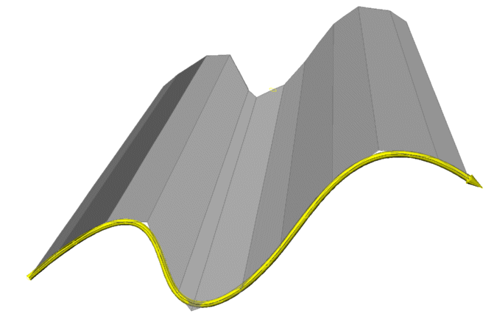
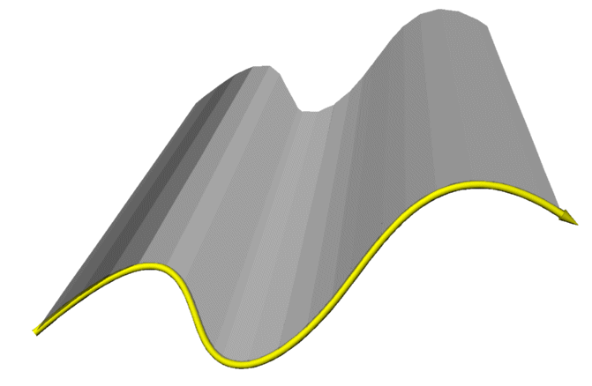
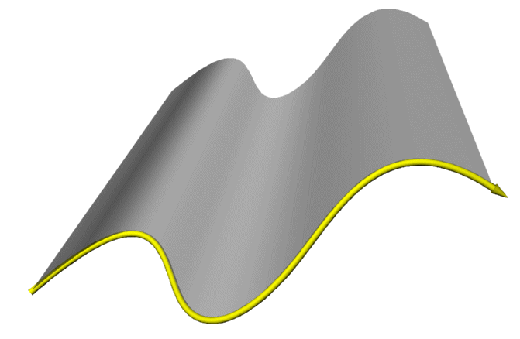
Developable Surfaces
0
Always zero
The limit of a family of planes

Slide 72
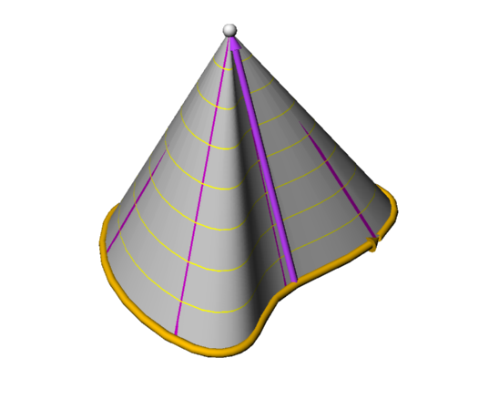
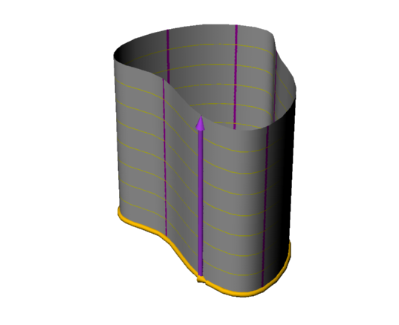
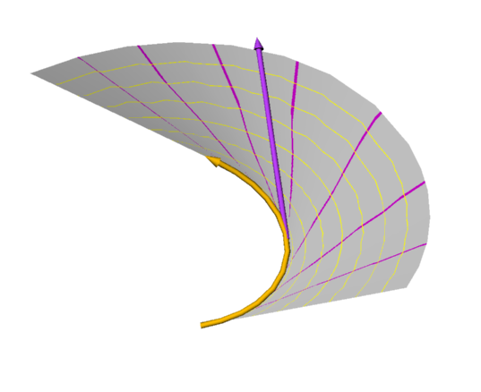
Developable Surface Types

Slide 73
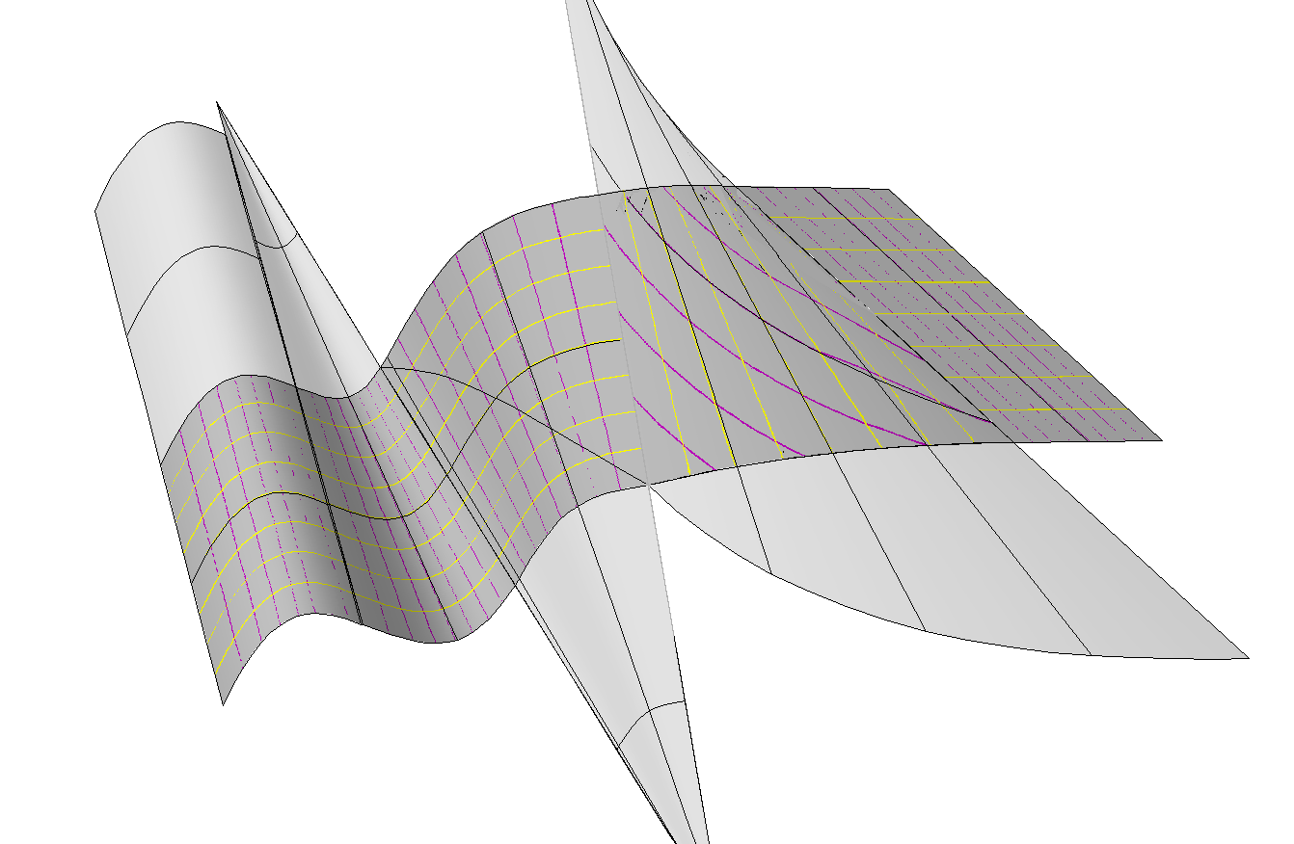
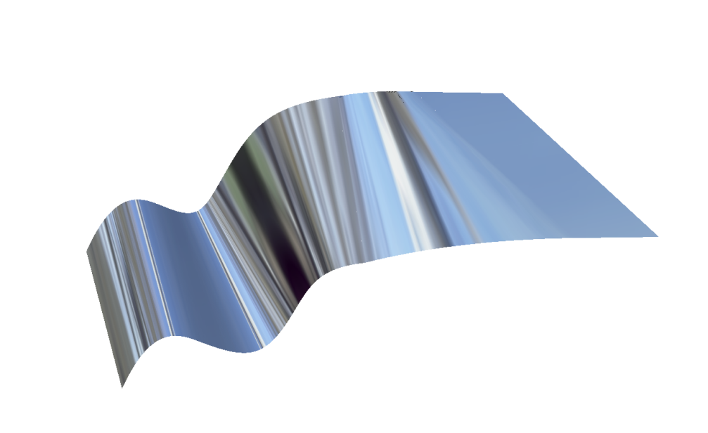
Developable Surfaces
0
Always zero

Slide 74
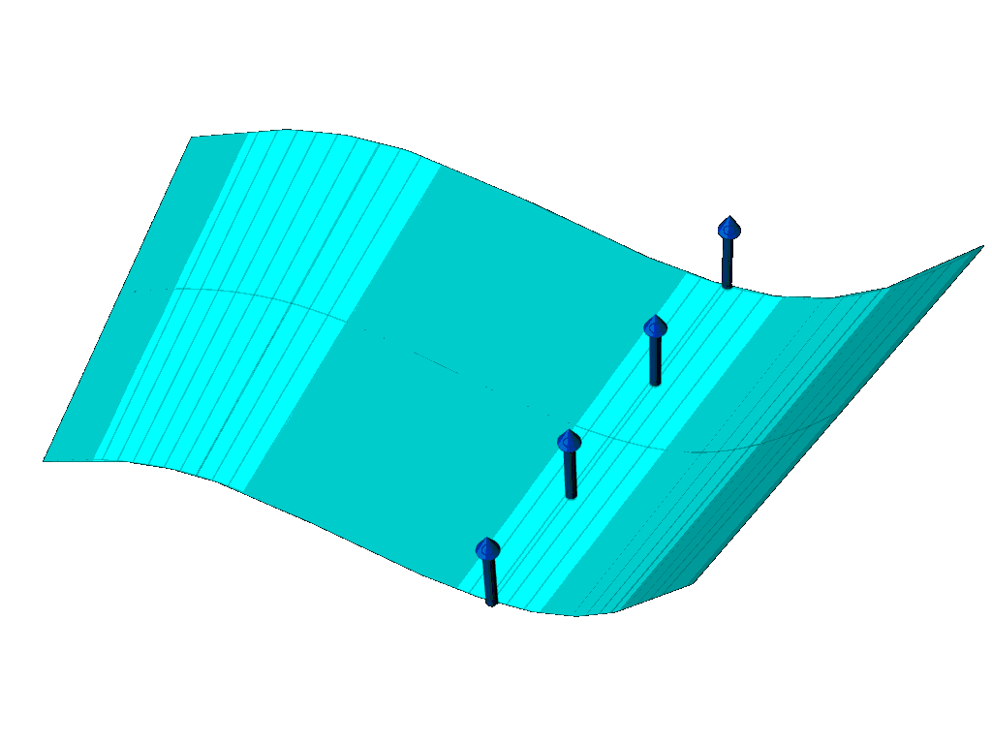
Ruled Surfaces
The envelope of a line along a curve in space
pointwise joining of
2 curves

Slide 75
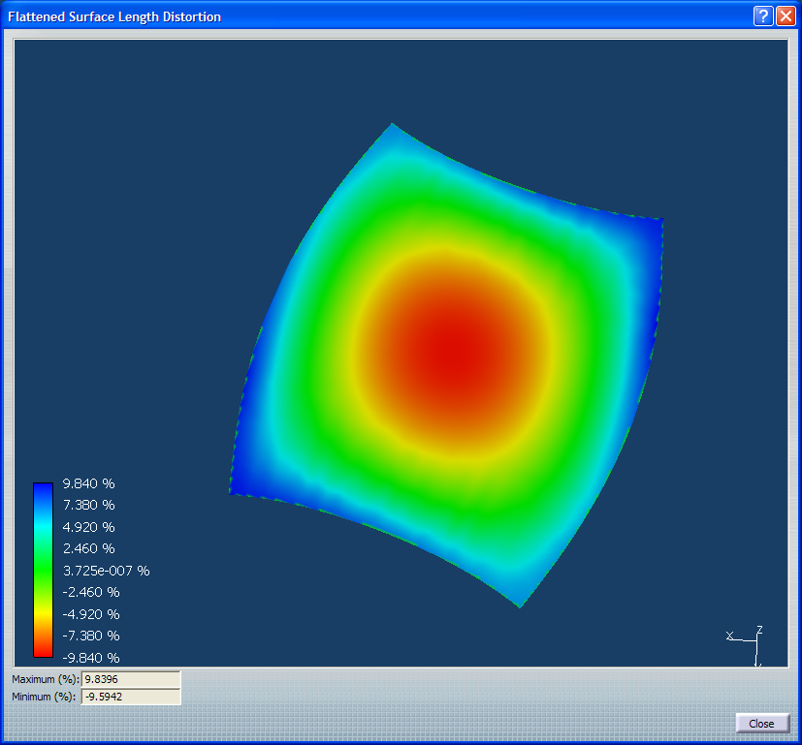
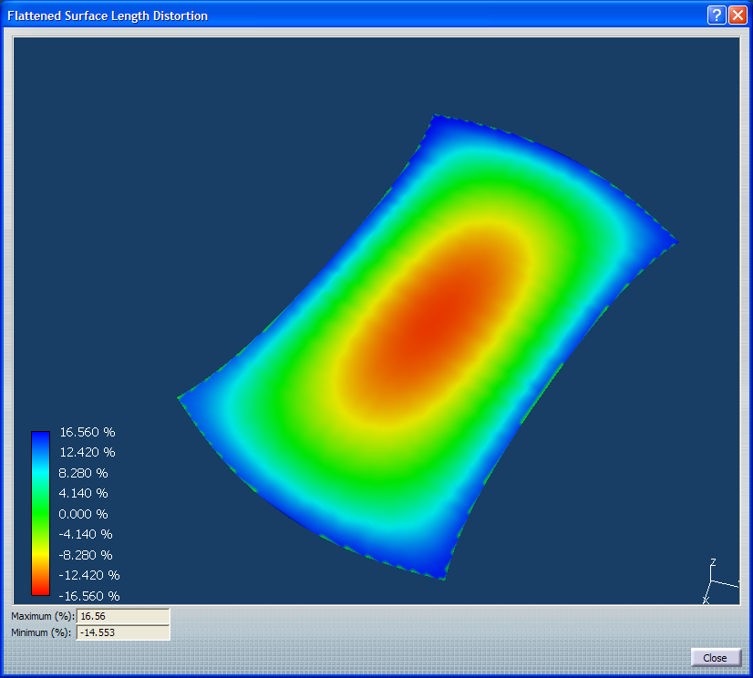
Deformed Surfaces

